Slide 1
Design, Construction and Operation of a Landfill Gas Collection System at the Highway 101 landfill in Sackville, Nova Scotia.
Highland Energy (N.S.) Inc.

Slide 2
Construction
Nov 2005 – Jan 2006
Installation of 74 wells
Dec 2005 – Feb 2006
Installation of 14 000 ft of electro fused HDEP pipe connecting all the wells to a main header line (2 000 ft), terminating at the gas treatment plant

Slide 3
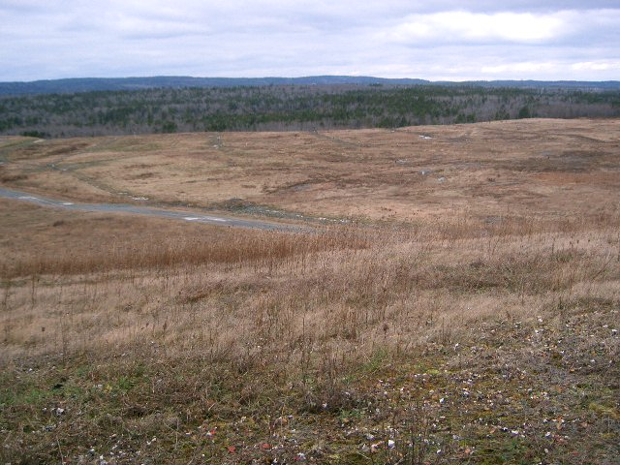
Highway 101 landfill
  Landfill operated from 1976 to 1997
  4 million tons of waste landfilled
  Area of landfill: 34 hectares
Highland Energy Inc.

Slide 4
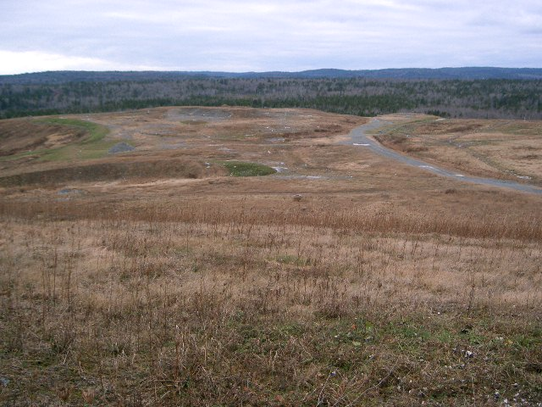
  Depth: 15 to 30 meters
  Leachate treatment plant installed
  Passive leachate collection system
Highland Energy Inc.

Slide 5
  Leachate was not pumped from landfill
  Cover was inadequate (landfill was wet)
  Leachate level is high in the landfill
Highland Energy Inc.

Slide 6
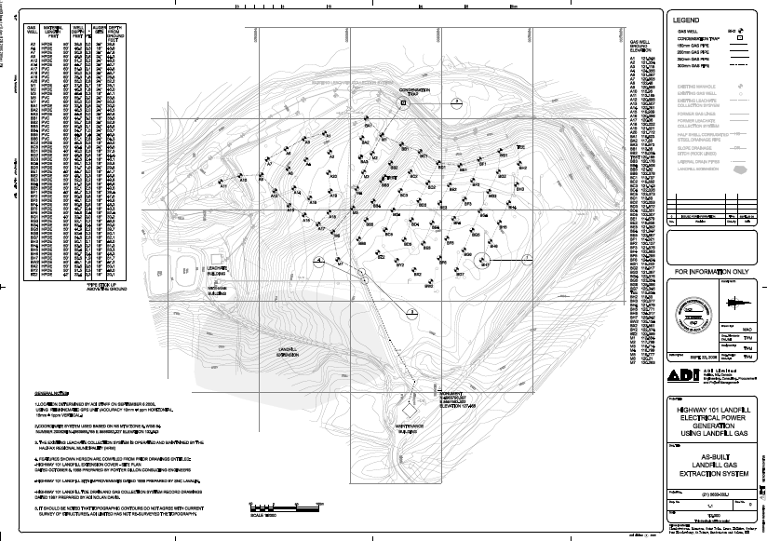
Well and collection system design

Slide 7
The collection system had to be pitched in order to allow the condensate and leachate to drain naturally from the collection system

Slide 8
Collection system
  Special drill required because of high leachate level
  HDPE pipe used for the collection system
  Valves strategically placed to isolate headers
  System laid out to allow natural drainage
  Each well has:
    a valve to regulate flow
    a port to sample quality and quantity of the LFG

Slide 9
Diagram of the condensate trap for the collection system

Slide 11
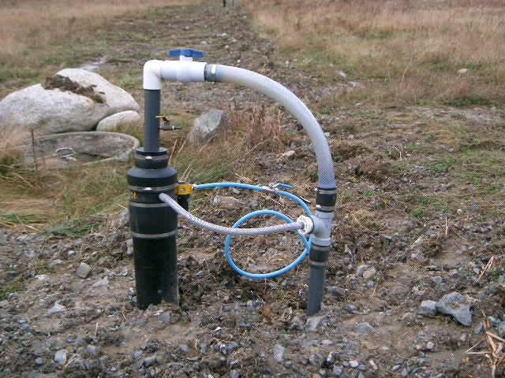

Slide 12
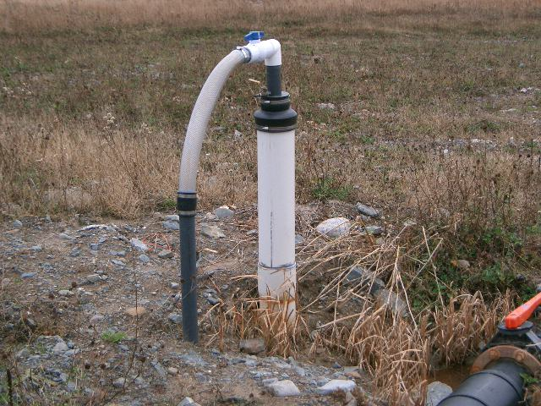
Highland Energy Inc.

Slide 13
Operations
LGC system is monitored daily
Wells are individually checked for CH₄ and O₂ levels
Leachate level in each well is checked regularly and is pumped with special designed air-driven pumps

Slide 14
Management of the collection of landfill gas is labor intensive and must be micro-managed constantly

